Slide 1
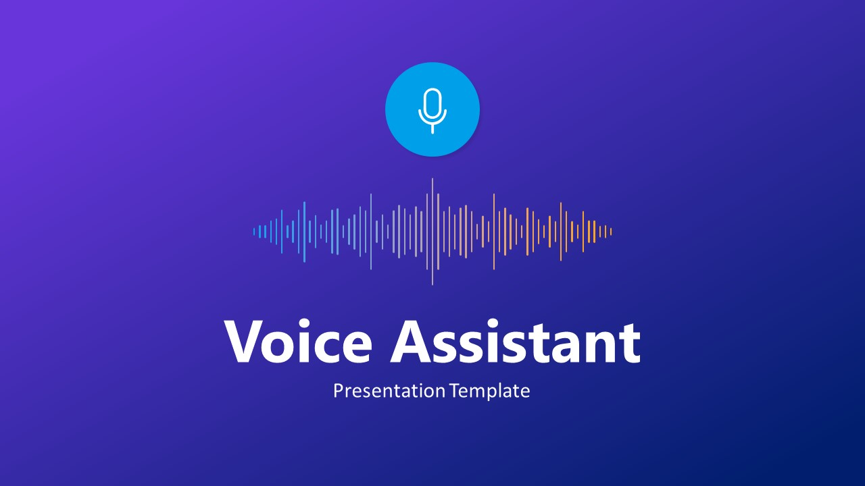



JEPPIAAR INSTITUTE OF TECHNOLOGY
“Self-Belief | Self Discipline | Self Respect”
Department of Computer Science and Engineering
Bolt Voice Assistant
Demo ppt

Slide 2
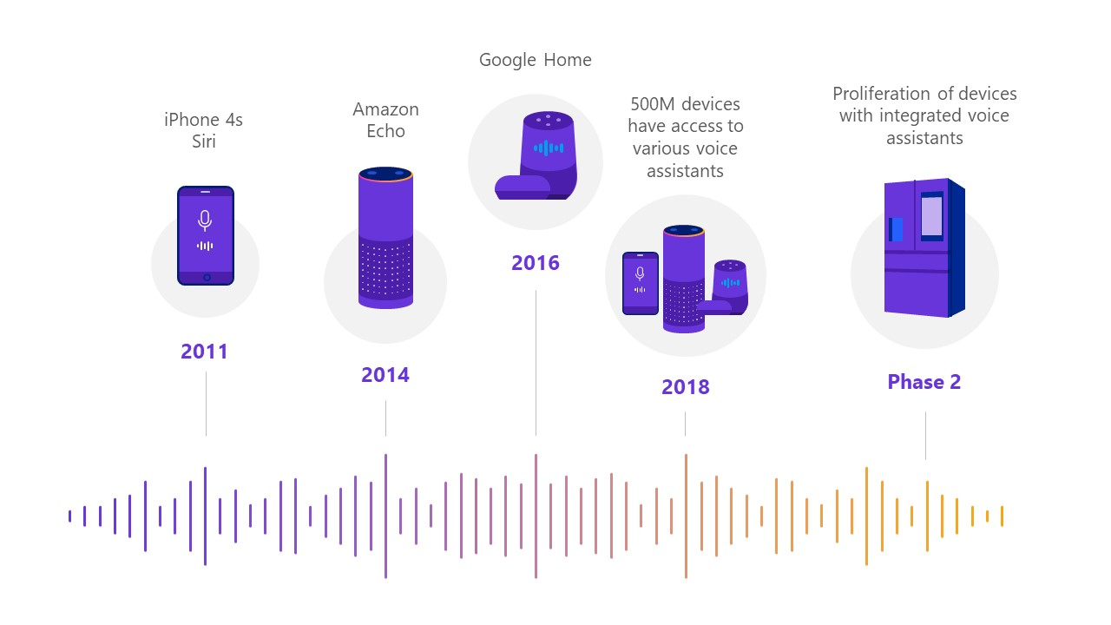
What is voice assistant ?
A voice assistant is a digital assistant that uses voice recognition, language processing algorithms, and voice synthesis to listen to specific voice commands and return relevant information or perform specific functions as requested by the user.
Bolt Voice Assistant
Demo ppt

Slide 3
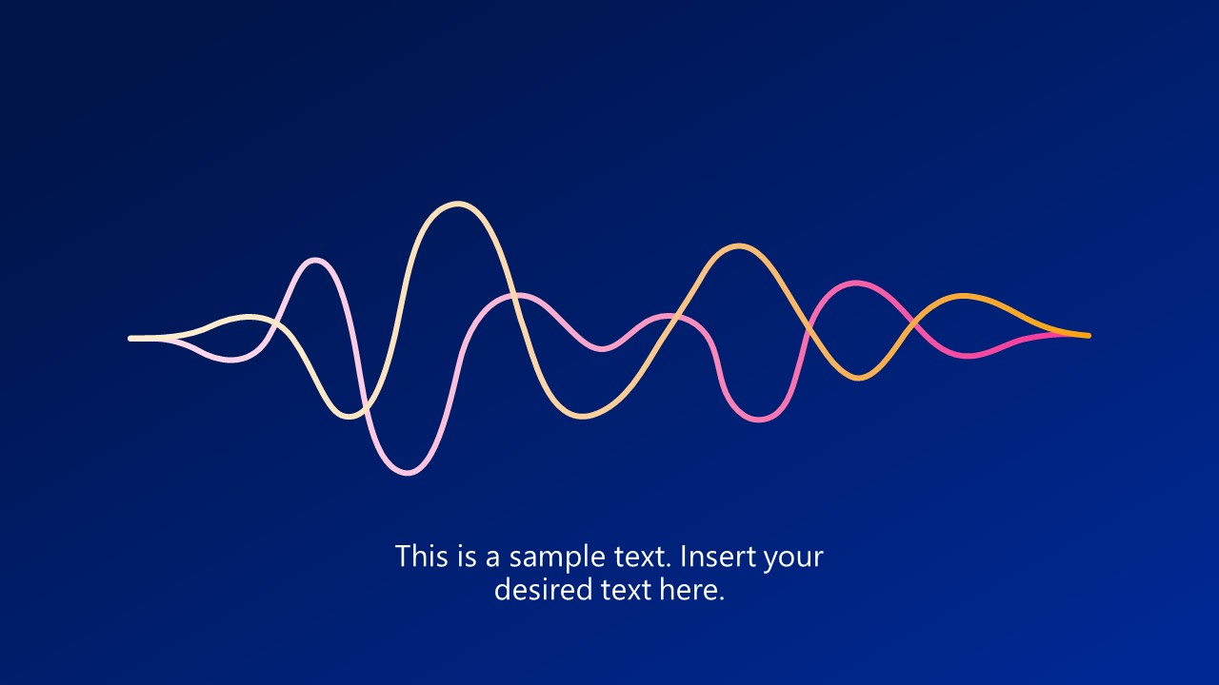
Why Bolt voice assistants are required ?
Helps people with disabilities:
One of the best things about digital voice assistants is that they enable hands-free operations. With a voice assistant, you won’t need to touch your screen or even type anything; all you need to do is call it by name.
Save money on your energy bills :
Virtual assistants can control smart home devices, including next-gen lighting options.and reminds you before the due date to avoid penalties
Help With Your Distress
Sure, digital voice assistants can be fun to use, but also, they can be therapeutic. They can help you meditate and lead you on breathing exercises to help you relax. With these features, you can reduce stress levels from a single voice command.
Saves time :
You can use vice assistant to automate so many things in your home like lights and fa and other electronical or electronic appliances you can also configure to send email or send a whatsapp messages and other things,
Bolt Voice Assistant
Demo ppt

Slide 4
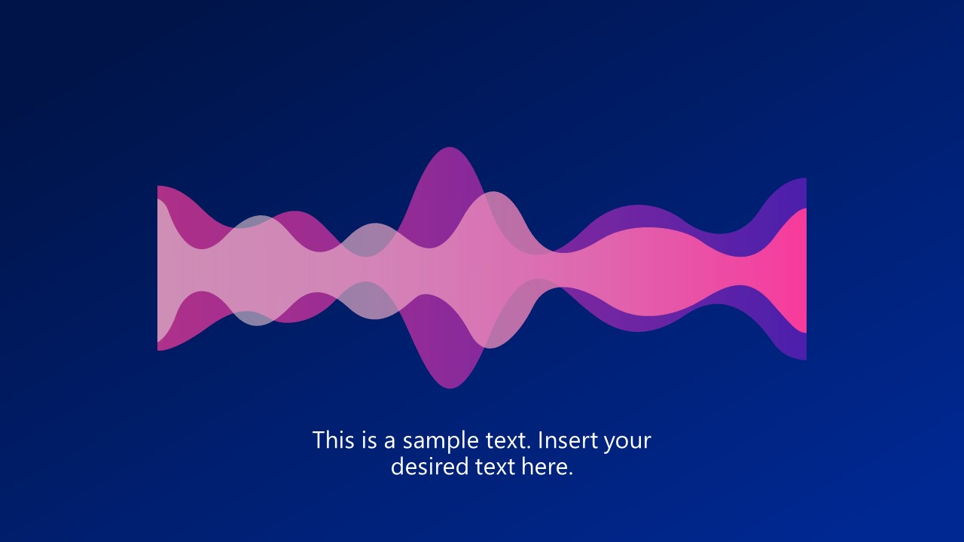
Disadvantages of Bolt voice assistants ?
Signal Strength :
One of the disadvantages of digital voice assistants is that they are limited to areas with a high-speed network. If you live in an area with no access to the 4G network, you’ll have difficulty keeping them alive. This means that most people residing in the rural areas of remote places cannot get the best out of them.
Voice is Essential
Another limitation about digital voice assistants is that only voice commands can operate them. Also, to get the best results out of your voice assistant, your voice should be audible and clear. if you’re in the club or a meeting, you won’t be able to access your voice assistant. This is because these places might be too noisy for your voice assistant to pick on your voice commands.
Bolt Voice Assistant
Conclusion
While digital voice assistants have their limitations, you can’t deny that they enhance convenience and comfort in a smart home. With more updates lined up for voice assistants, the future of home automation is in good hands.
Demo ppt

Slide 5
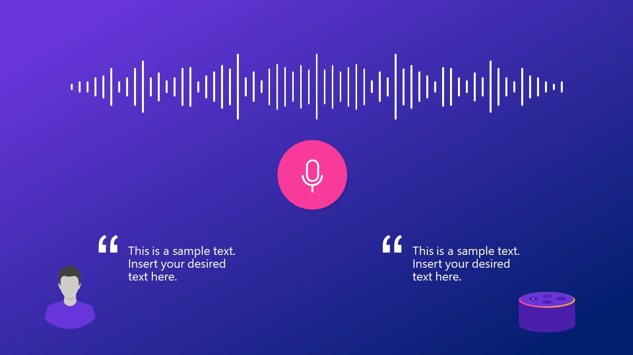

Bolt Voice Assistant
Bolt is a very simple voice assistant made only by using nearly 200 lines of simple python functions such as “if and ‘elif’ statements and with nearly 15 python modules
Bolt Voice Assistant
Hello bolt…..
Hello sir, how are you ?
Demo ppt

Slide 6
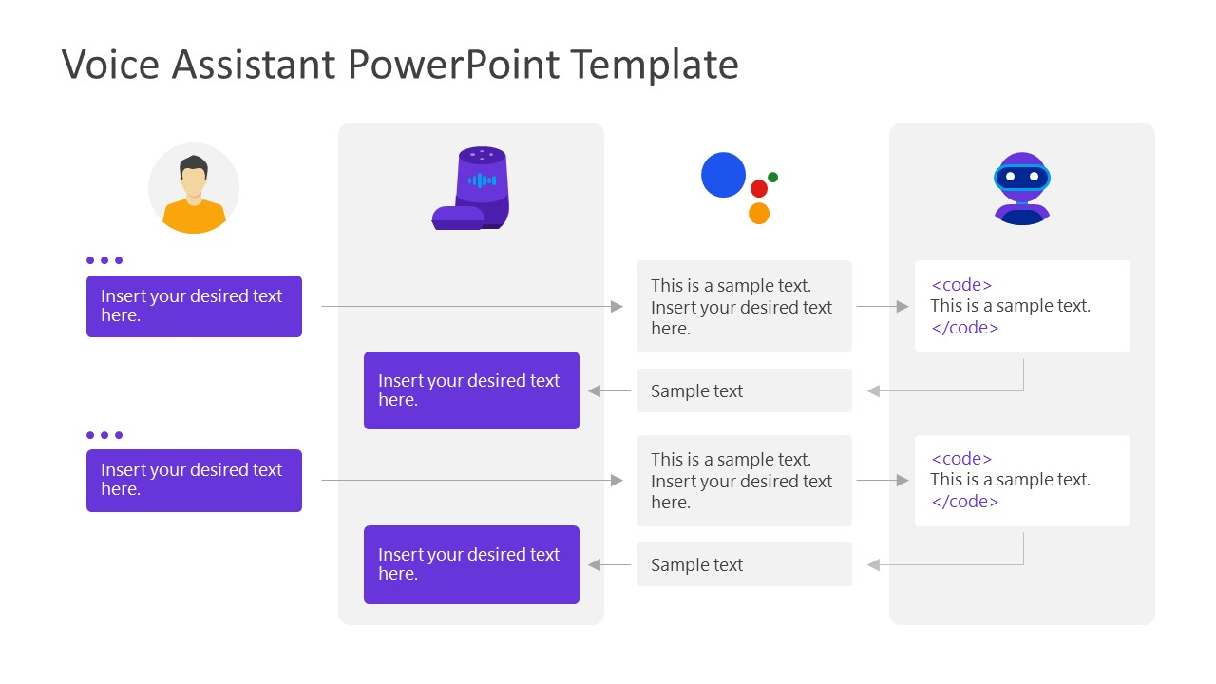
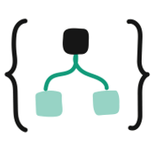

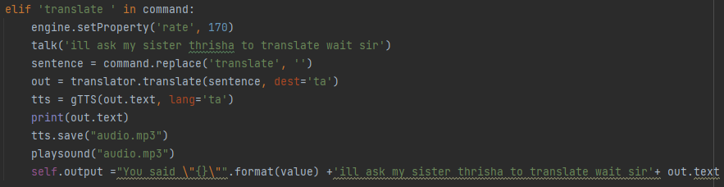
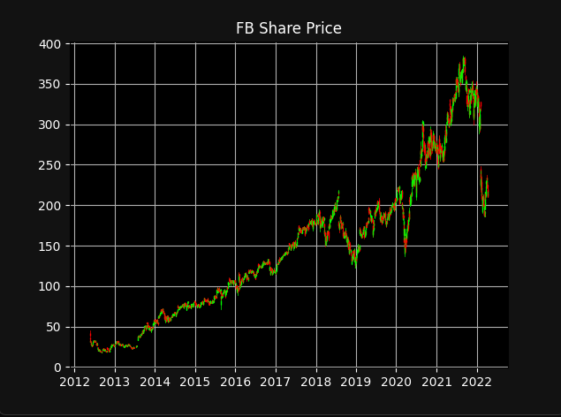
How does Bolt work
Searches for code block related to keyword translate
Bolt translate “hi how are you” in tamil.
Translating sir….
வணக்கம் எப்படி இருக்கிறாய்
Gets the desired output
Bolt show me the stocks of FB
Searches for code block related to keyword stocks
This is what I found sir
Gets the desired output

Slide 7
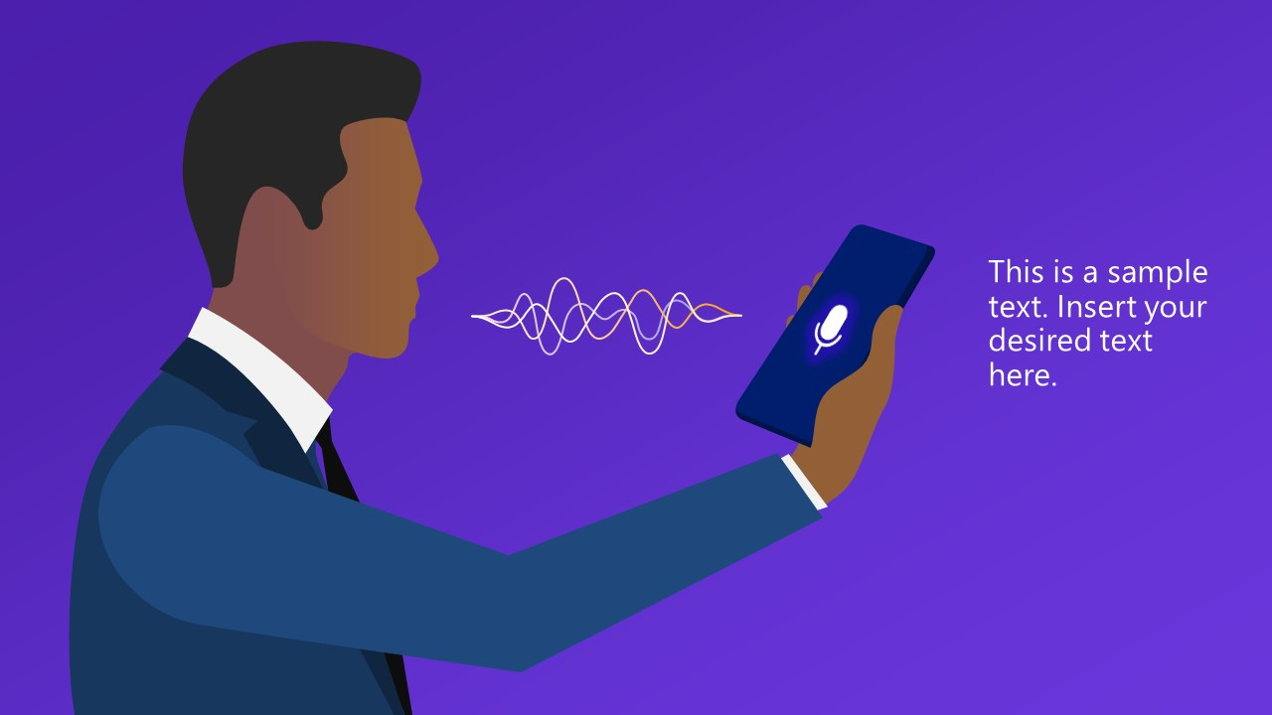
BOLT FEATURES
Bolt can do tasks like…
Playing songs (use ‘bolt play_your song’)
Translate from English to tamil(use ‘translate_your input’)
Take notes in handwriting format (use ‘take note’)
Visualise stock prices (use ‘show stocks’)
Translate from tamil to English(use ‘your input_in English’)
Send message in whatsapp (use ‘send message_your message’)
Ask time (use ‘tell time’)
Ask about someone (use ‘who is_your query’)
Set Alarm (use ‘set alarm’)
List commands (use ‘what can you do’)
Introduce itself (use ‘who are you’)
Open or close apps (use ‘open’ or ‘close’ respectively)
Opening websites (use ‘goto_youtube,facebook….
Google something (use ‘google _your query’)
Predict stocks using ML(use ‘guess’ )

Slide 8

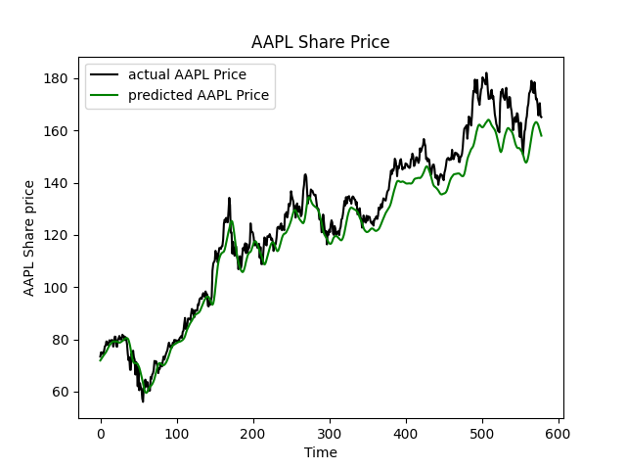
How Bolt Stock Predictions Works
Retrieves current and past stock values of a company from yahoo finance and reads the data available
Uses keras sequential models to create a neural network from the retrieved data and creates multiple layers of data
Bolt analyzes the multi layered data by the process of deep learning and predicts the values
With the help of matplotlib a graph is plotted sing the given values
Searches for code block related to keyword translate

Slide 9
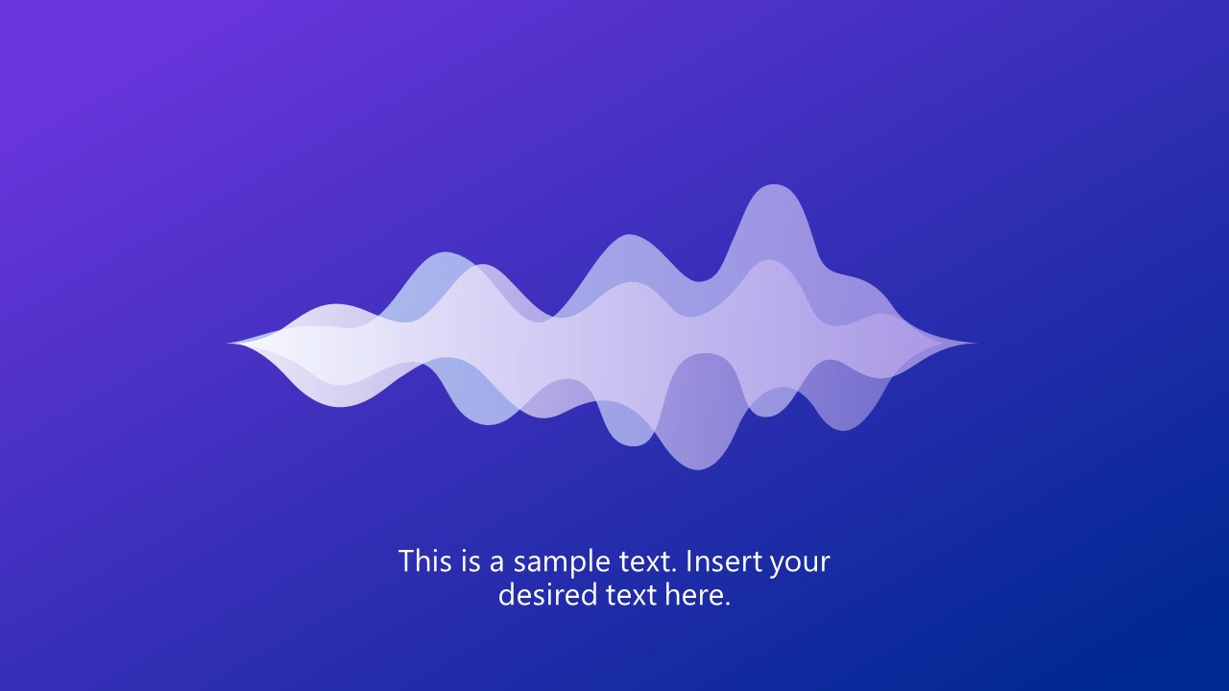
THE END

Slide 10
THANK YOU
A Python Project by:
Kamalnath - 210620104025
Kishorekumar - 210620104030
Akshay - 210620104004

